Slide 1
Perspective & Focus
Assume we are the restaurant network operator, overseeing a portfolio of restaurants across multiple cities.
My primary focus in this analysis is on the Order and Revenue perspective.
The goal is to identify revenue drivers, performance patterns, and menu profitability insights that can guide strategic business decisions.

Slide 2
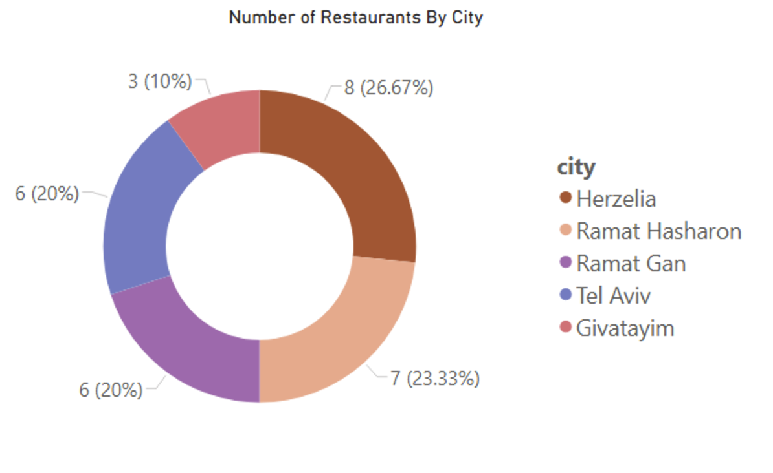
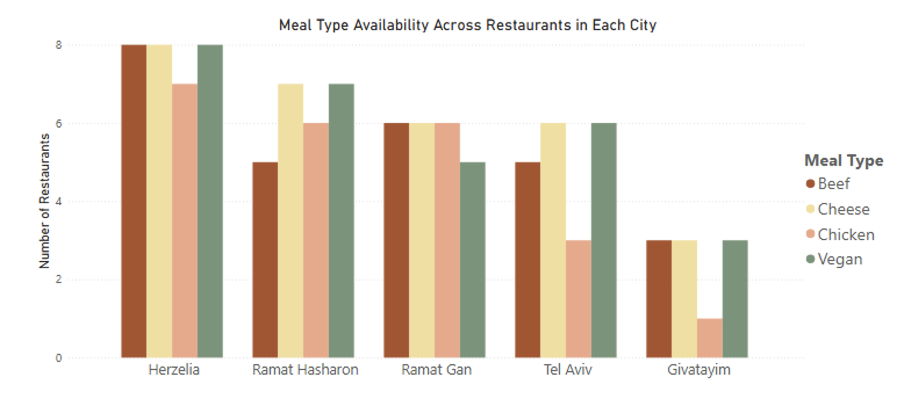
Summary
5 Cities (Herzelia, Ramat Hasharon, Ramat Gan, Tel Aviv, Giyatayim)
30 Restaurant, 5 Restaurant Types (Asian, Fast Food, Homemade, Indian, Italian)
4 Meal Types (Vegan, Cheese, Beef, Chicken)
36,000 Orders in total, generating a total revenue of $3.16M
On average, each restaurant handles 1,200 orders, with an average order value of $88
* The data is from Jan 2020 to July 2020

Slide 3
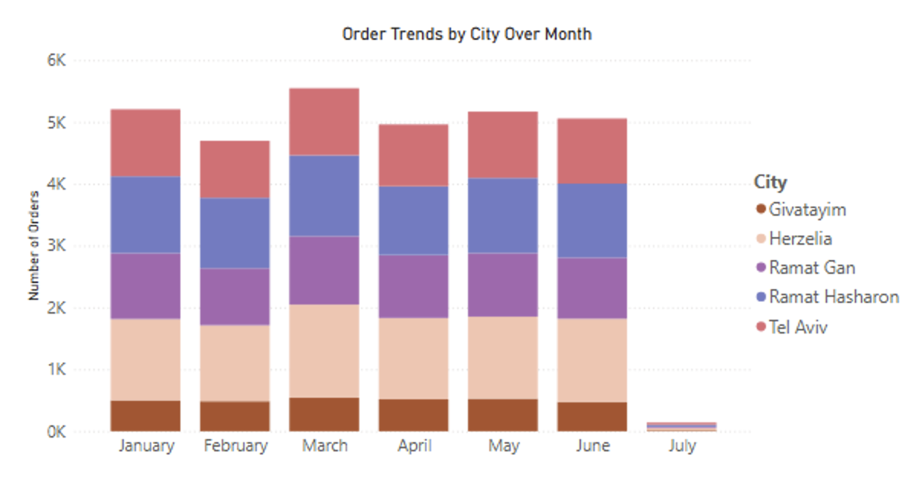
Order & Revenue Analysis
Order volumes remain consistent across cities, with Tel Aviv and Ramat Hasharon showing slightly higher order counts.
March is the peak month across all cities
Monthly revenue per restaurant across all cities is approximately $17K to $19K. Per-restaurant revenue is balanced across locations.
Top 5 Restaurants by Monthly Revenue are:
These restaurants consistently outperform the network average monthly revenue (~$17K–$19K).
City | Ramat Gan | Herzelia | Tel Aviv | Herzelia | Ramat Gan
Restaurant Name | Restaurant 10 | Restaurant 11 | Restaurant 30 | Restaurant 4 | Restaurant 20
Notes:
Understand where, when, and how revenue and order volumes are being generated to inform targeted growth strategies and operational resource allocation

Slide 4
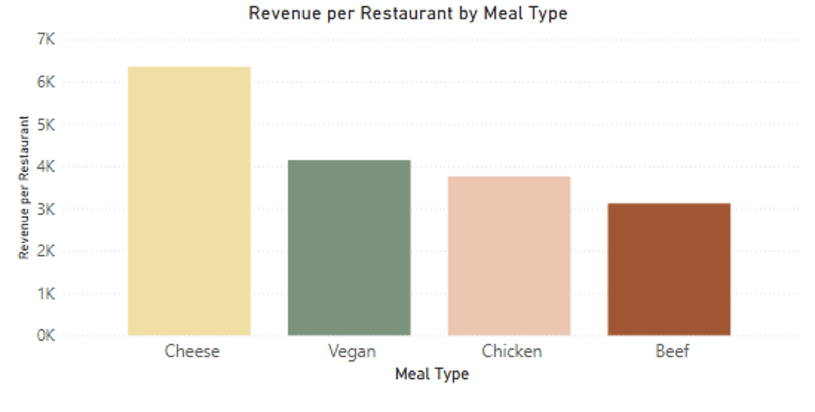
Order & Revenue Analysis
Cheese-based meals generate the highest revenue per restaurant, outperforming Vegan, Chicken, and Beef categories.
Order volumes for Hot and Cold meals are similar.
Despite similar volumes, Hot meals command higher price points.
Top 5 highest-priced meals:
These are priced above $80 per order
Meal Name | Type | Hot/Cold
Meal 119 | Desert | Hot
Meal 75 | Desert | Hot
Meal 209 | Desert | Hot
Meal 236 | Starter | Hot
Meal 269 | Main | Hot
Notes:
Understand where, when, and how revenue and order volumes are being generated to inform targeted growth strategies and operational resource allocation

Slide 5
Recommendation
More Restaurants in Giyatayim
Cities like Givatayim contribute lower total revenue due to a smaller restaurant footprint, not inefficiency.
Targeted Investments and Support
Focus marketing support, staff incentives and menu innovation on high-revenue restaurants to amplify their performance
Plan targeted promotions and capacity strategies around March to maximise revenue.
Prioritize High-Impact Men
Expand high-performing meal categories (Cheese, Vegan, Hot Starters/Desserts) to uplift profitability
Notes:
Understand where, when, and how revenue and order volumes are being generated to inform targeted growth strategies and operational resource allocation

